Slide 1
Exploring sessional based services in Carmarthenshire
Notes:
Welsh National Charity and Co-operative, support people with learning disabilities all over Wales
We pride ourselves on putting the people we support at the heart of our decision making
We have a strong presence in Rhondda supporting over 70 people in supported living settings and sessional support

Slide 2
Context
Notes:
We’ve got a busy weekly event schedule with Monday – Rugby Club (Cement making workshop – making garden ornaments)

Slide 3
Conversations
‘someone who listens to me’
‘Someone who will exercise with me’
‘Someone who will paint with me’
‘Support me to talk to the Police’
‘Support me to go to the bank’
‘Support me read a book’
‘Support me to Knit’
‘Support me at college’
What Matters?
‘Support me to get the bus’
‘Support me to keep clean’
‘Support me with cooking’
‘Support me to clean my home’
‘Support me to wash my clothes’
‘Someone who will listen to music with me’
‘Support me to be a mum’
‘Support me to pay bills’
‘someone who will shop with me’

Slide 4
Day to Day Demand
Averaged 23 support calls per day
Averaged 71 demands per day
First attempt at check showed 30% failure demand
I expect this to rise with more training and understanding

Slide 5
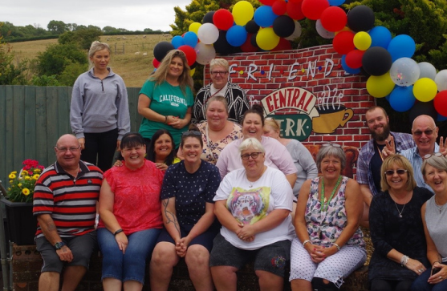
Capacity
Notes:
We’ve got a busy weekly event schedule with Monday – Rugby Club (Cement making workshop – making garden ornaments)

Slide 6
Capacity = Value Work + Waste
Our Capacity on the surface looked ok…
Time and task working dilutes value work and builds in waste
Systems unable to cope with change in demand
Pressure to deliver hours encourages strange behaviour
Capacity feels out of front-line staff’s control

Slide 7
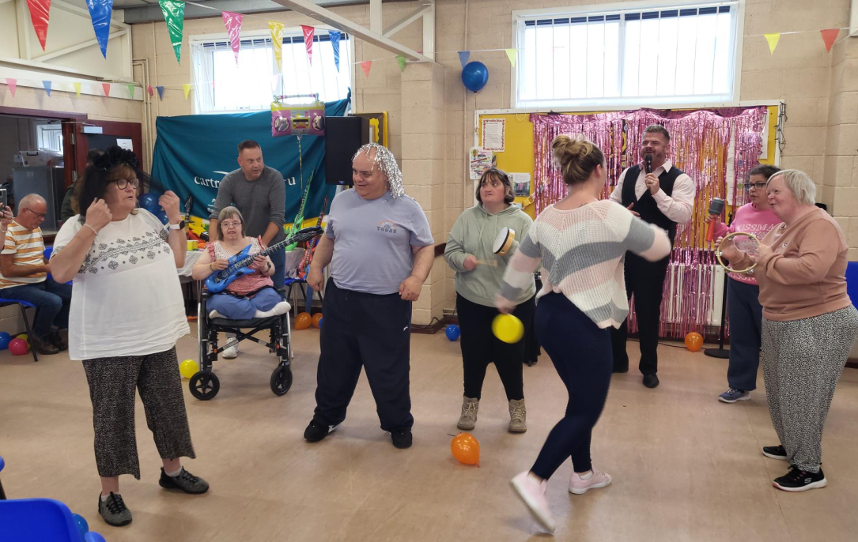
System Conditions

Slide 8
Time and Task Service Model

Slide 9
Time and Task…
Based on average time to complete tasks
Based on set commissioned tasks
Built in waste
No flexibility to meet the change in demand
Difficult to do what matters when it matters
Slow to change

Slide 10
Time and Task
Results in over and under prevision in lots of cases
People feel undervalued – numbers being sold
Staff feel under pressure
Staff behaviour changes in response to pressure
Heavily monitored – costs more in the end

Slide 11
Performance
30% demand is failure demand
5% of our calls are late
Difficulty changing support time/day
Delivery of hours is priority
Doing what matters becomes secondary

Slide 12
System
System is designed to deliver time and task
Time and task is designed to be easily quantifiable
Staff are deployed in blocks
Payroll / Finance / Rota’s all designed around delivering the hours!
Staff required to contact managers for a lot of things
Staff required to complete a large amount of paperwork

Slide 13
Thinking
Staff need to be told what to do – always!
We will not deliver hours and cash in
Little trust
People who need support, need the same support all the time

Slide 14
What was the plan?

Slide 15
We agreed to re-design and worked on a remit with Carmarthenshire.
We spent time consulting the people we support in how the pilot will operate. 6 people agreed to come on the journey with us.
Demand was being logged in the current time and task model to give us a baseline performance before we switched.

Slide 16
6 people we support identified who would benefit from a demand-based model.
Funding will stay the same but switch from PH to a pot of money.
Staff will be deployed in blocks to meet the demand.
Once the demand for the 6 people is being met comfortably, we took referrals until we filled all our capacity with value work.

Slide 17
Challenges What we found Tricky!

Slide 18
​
Communication - Getting the message across!
Care managers and brokers are finding it difficult​
Difficult to project travel expenditure​
Reliant on key relationships in local authorities

Slide 19
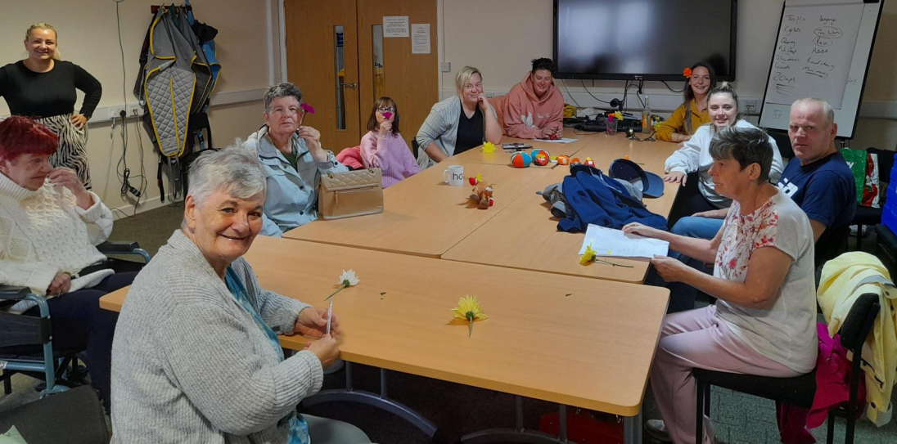
Moving Forward

Slide 20
How is it going
Pilot is still live
Our work has shown we have lots of capacity to help more people and referrals – We have supported double the people.
The people we support and staff are really embracing the new way of working.
Staff feel empowered and trusted to do the right thing.

Slide 21
Questions?

