Slide 1
Locality working – a provider perspective Neil Yates

Slide 2
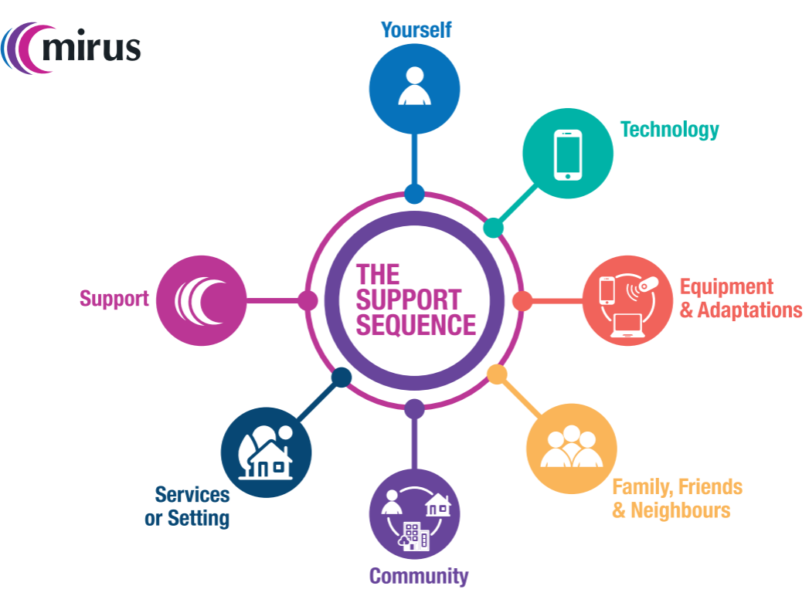
Supporting people to live a good life
Support Sequence;
Strengths based approach that enables people to work towards personal outcomes

Slide 3
Locality working
People developing friendships based on shared interest and passions
People are building their natural support networks, including increase of peer support
People being more active and contributing members of their communities
Locality working has enabled support to others in the community who currently receive little or no support themselves
Better experience for staff and volunteers – seen through recruitment, retention and positive stories
Collaboration with local groups and organisations to support and develop inclusive initiatives, building community capacity to do more
Key principles – develop relationships and take action, enable local decision making and positive risk taking

Slide 4
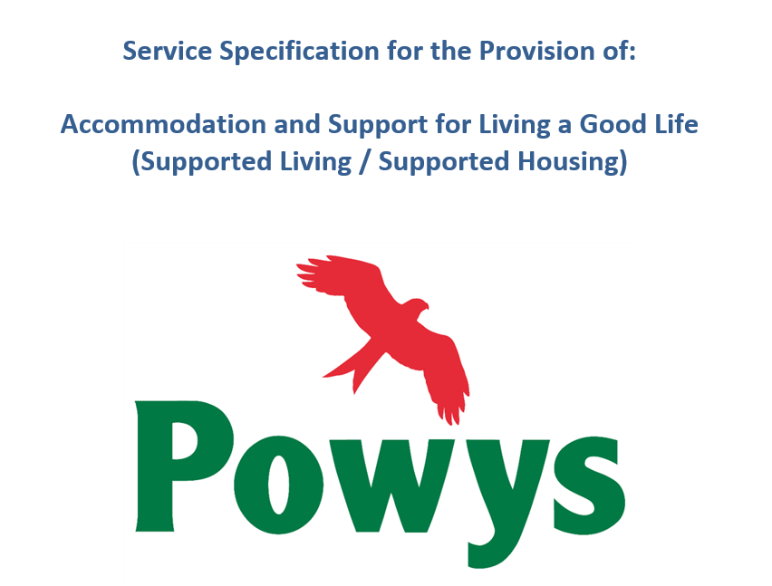
Locality working
Commissioning enables providers to work in this way;
Examples from Powys

Slide 5
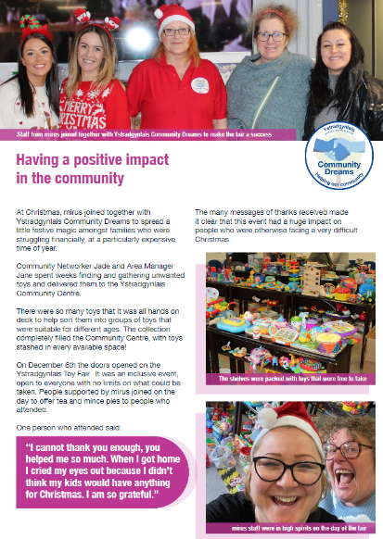
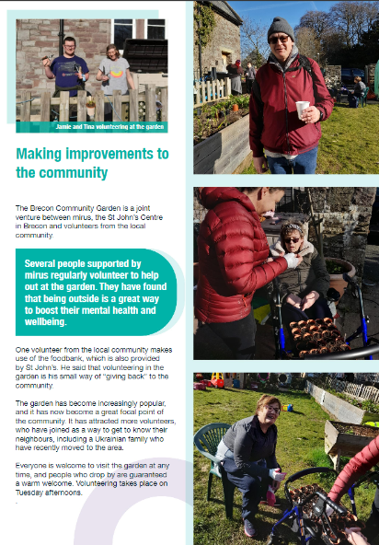
Supporting people to live a good life

Slide 6
Locality working
We are asking ourselves;
How can we support a broader range of people by working with other support providers, local groups and organisations?
How can we co-locate with others and share resources, infrastructure and ideas?
How can we join up our ‘better together’ coproduction process to inform and influence local service and policy development?
How can we evaluate this way of working to demonstrate impact and to share learning?
How can locality working be inclusive of those with more complex support needs and those people and families who want to self direct their support?

