Slide 1
Drive Community Projects
Person-centred Support

Slide 2
Supported Living Provider
Working in South East Wales for 30 years in partnership with Local Authorities and Housing Associations to support people with learning disabilities to live their best lives in their local communities.

Slide 3
Work in partnership to…
Create alternatives to traditional Day services based on what people have told us they want to do: work, volunteer, create, contribute.
Support the Closer to Home initiative: prevent people from being placed in expensive, out of county placements
Reduce reliance on statutory services by developing opportunities with local community groups, businesses.
Maximise resources by positive collaboration with other providers

Slide 4
Project 1 ECO project for young Autistic adults
Redesign the space
Upskill staff training to provide complex support
Provide placements for Learning Disability Nurses
Develop opportunities to sell produce, work with local distributors
Develop recycling and composting initiatives
Supporting wellbeing
Utilized a range of grants to develop the project from general to specialist support
Without the project – specialist residential provision???

Slide 6
Woodworking skills

Slide 7
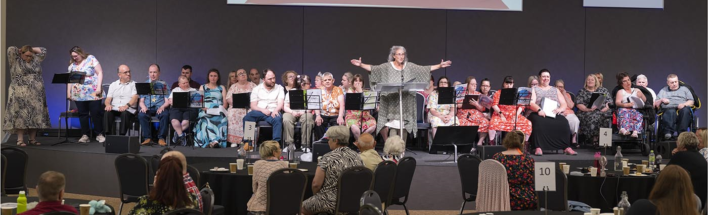
Better Together Events
Bring Community partners, Providers, People First, Local Authority together to:
Find out what people want to access
Map what is available
Design a space to regularly share information – websites/Insight App
Look at how we can share resources
Create any ‘missing’ opportunities

Slide 8
The outcomes from community mapping and partnerships
Training
Parties
Dance & Fitness
Friendship Clubs
Art & Craft
Music
Snooker / Pool
Training kitchen
Connect hubs
DIY and repairs
Garden maintenance
IT skills
Walking in the Woods
Mindfulness activities
Gardening and Horticulture
Sensory gardens
Outdoor sports and games
Design outdoor spaces
Litter pick up in parks
Footpath maintenance
Bird feeders
Opportunities to work/volunteer
Choir
Touch Trust
Zumba
Kickboxing
Card-making
Crafts / Sewing
Dance
Healthy cooking
Life skills
Bus travel training
Recycling cafes
Fundraising events
Interviewing
Bingo
Quiz night
Karaoke
Choir
Slimming club
Coffee morning
Cooking classes
Learning BSL
Digital photography
Making videos
Training

Slide 9
Positive commissioning
Repetitive competitive tendering | Partnerships
Discourages collaboration with other providers | Encourages a Better Together approach
Creates uncertainty for staff, supported people, families, other businesses | Business is sustainable with certainty around career paths and future
Measuring time and task – rigid use of resources | Flexible approach to facilitate innovation
Short contracts don’t allow for innovation and development with communities and partners | Long contracts give time to build relationships, develop new models of support
Lack of consultation re: service developments | People being support, families, providers, community partners are regularly

