Slide 1
Background
The Code of Practice for Part 2 of the SS&WB Act and the guidance for Part 9 have been redrafted to provide clearer and stronger requirements for implementing the Section 16 duty
The duty requires LAs to promote social enterprises, cooperatives, user-led services and other third sector organisations for the provision of care and support and preventative services.
The previous requirement for RPBs to create “Social Value Forums” is to become a requirement for “Section 16 Forums”.

Slide 2
The core aims of Section 16 Forums
Transforming care to achieve greater well-being and sustainability
Rebalancing the care market to achieve greater diversity of sectors

Slide 3
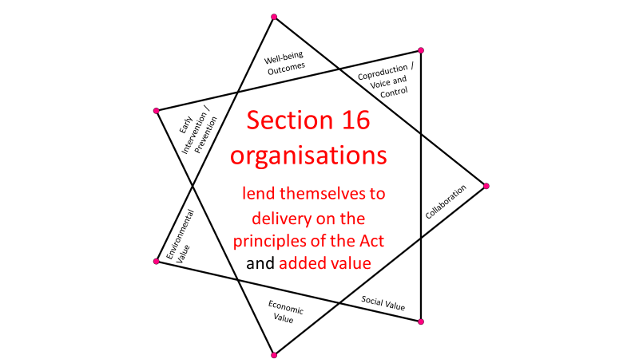
The transformation aim of Section 16 Forums

Slide 4
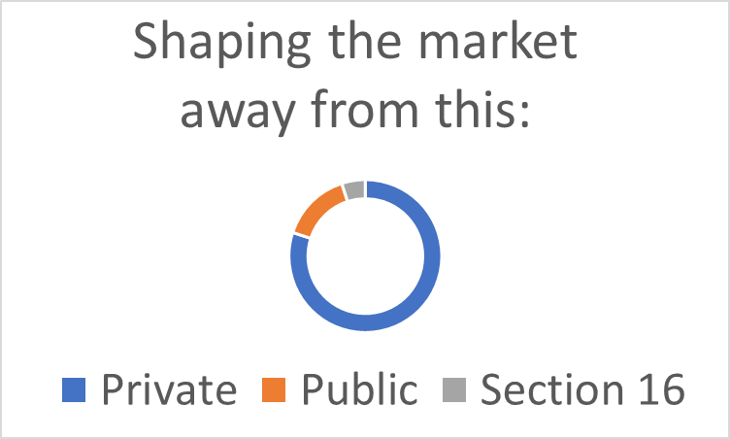
The rebalancing aim of Section 16 Forums

Slide 5
Reasons to collaborate with s16 agencies
Values aligned with the principles of the Act
Well-being outcomes: Doing what matters - as people define it
Co-production: Mobilising people’s own opinions and assets – including community assets
Co-operation: Working with others for shared public benefit
Prevention: Thinking long-term and acting to reduce or avoid dependency
Added Value: Striving to go beyond just delivering a contract

Slide 6
Reasons to collaborate with s16 agencies
Values aligned with the principles of the Act | The principles of the Radical Redesign Group
Well-being outcomes: Doing what matters - as people define it | Ensure money is spent on achieving outcomes with people
Co-production: Mobilising people’s own opinions and assets – including community assets | Help people to contribute to their communities
Co-operation: Working with others for shared public benefit | Create collaborative learning for all involved stakeholders
Prevention: Thinking long-term and acting to reduce or avoid dependency | Maximise citizen control
Added Value: Striving to go beyond just delivering a contract | Maximise the quality of employment that underpins support

